Slide 1
Woodland Public Schools
Facilities and Safety Report
For May 2016

Slide 2
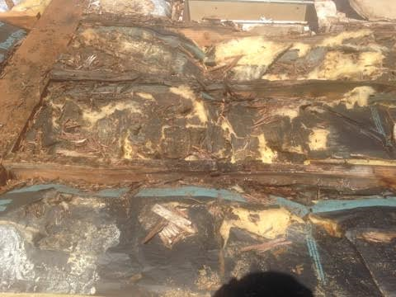
FACILITIES REPORT
Water Sampling Results
Preliminary water samples were sent to BSK labs (formerly Addie labs), drawn at strategic locations throughout the schools, based on the physical arrangement of the piping systems. Samples were drawn in accordance with the Washington State Department of health publication #331-261 (testing for lead in school water drinking systems). Only one sample had any detectable lead at 2.9 ppb (.0029ppm). This is an order of magnitude below the action level for lead (20ppb). As a proactive step we also had the samples analyzed for copper, as well as lead. This will be a requirement in July of 2017 (WAC 246-366A-135). All samples (excluding 2 ) had some level of copper ranging from .086 ppm up to the action level of 1.3 ppm. All testing at this time is voluntary, but will be mandatory next year. Additional samples will be drawn over the next two months to further shore up our preliminary results.
Mezzanine Roof WMS
The mezzanine roof is complete, with the exception of one area that will require replacement of three purlins. Each purlin is approximately 15 feet long. There were 9 areas found that required substantial repair that included “sandwiching” the existing purlins to provide a suitable anchor for the new decking. This last area is significantly damaged and warranted engineering assessments.
DAMAGED PURLINS ATTACHED TO ROOF TRUSSES

Slide 3
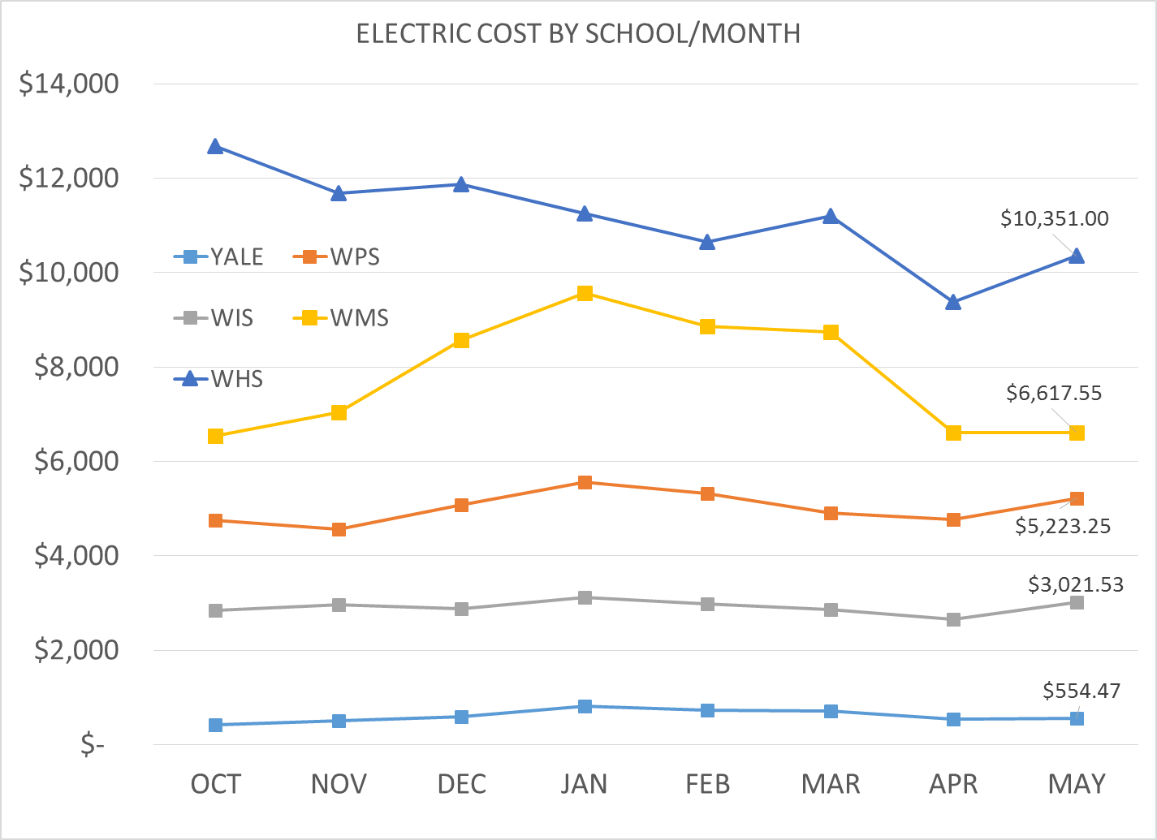
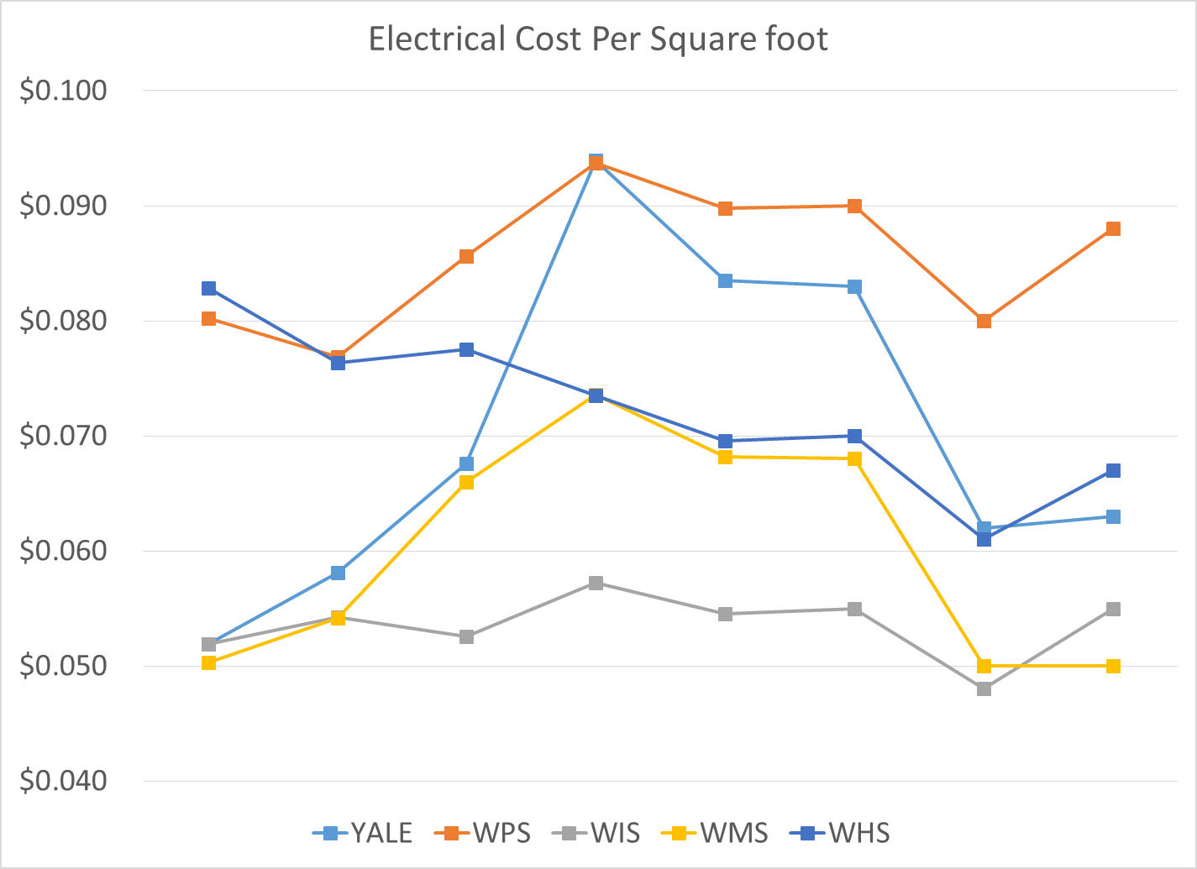
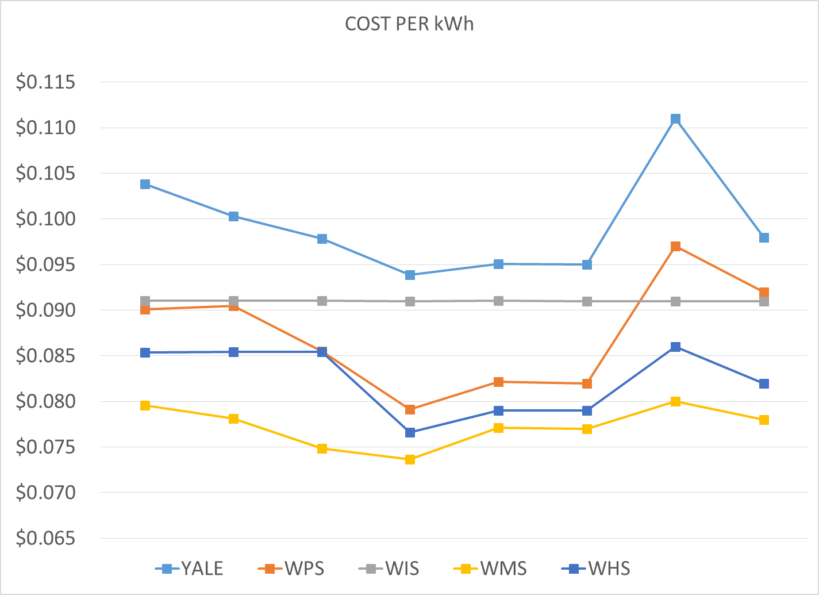
Electric Cost
Although it looks like power cost has gone up for the High School and the Middle School campuses, the exact opposite is true. There were 28 billing days in April and 31 billing days in May. Cost for WMS averaged $235/day in April and $213/day in May. High School costs were essentially flat at $334/day in April and $333/day in May.

Slide 4
SAFETY
Accidents for the Month
There were a total of 21 injuries in the month of May; 11 students and 10 staff members.
There was an alarming uptick in accidents related to students behavior at the Woodland Primary School in the month of May . This included 7 incidents related to students responding violently to direction from IA’s and teachers. I have asked for some time with Ingrid and some of her key staff, to find ways to better protect our employees from harms way…more to follow on this topic.
Staff Accidents/Incidents (10)
DO – Employee slipped on ADA ramp, contusion to knee and toe.
WPS - Angry student kicked employees knee, aggravated existing injury.
WPS – Angry student kicked employee, bruising lower calf.
WPS -Angry student kicked employee, bruising right shin.
WPS – Angry student pinched, clawed left forearm then broke skin on shoulder with pencil.
WPS - Angry student threw container of playdough at the back of employee’s head.
WPS - Angry student bit employee right forearm.
WPS – Angry student bit employee while being escorted to quiet room.
WMS – Employee fell on sidewalk, head injury (no reason sited).
WIS – Employee slipped on lettuce in hallway, knee injury.

Slide 5
Student Accidents (11)
WPS – Student fell off chair hit head, bruise.
WIS –Fell from monkey bar, fractured arm.
WIS- Fell backwards off chair, hit back.
WIS- Bench knocked over, hurt finger.
PIT house- student twisted ankle on grass.
PIT house – Bee sting, hand.
WMS –Student hit opening door when rounding the corner, hitting nose.
WMS – Upset student kicked bleacher, sprained ankle and chipped bone.
WMS – Student rolled ankle at pacer test.
WHS – Student looked away while other student through medicine ball, finger strain
WHS – Student dropped metal on foot while cleaning shop, bruised foot.

Slide 6
